Slide 1
Exceptions (http://docs.oracle.com/javase/tutorial/essential/exceptions/index.html)
Notes:
A software is usually organized as a folder. A folder containing java classes is call as a package but this folder must be created by the Java complier.
We all experience about unpleasant feeling when facing errors or exceptions caused by a software. Now you are programmers, you surely do not want your programs existing errors implicitly.

Slide 2
Objectives
Exception
Kinds of Exception
Exception Handling
Examples

Slide 3
Exception
Exception is an event, which occurs during the execution of a program, that disrupts the normal flow of the program's instructions.
For example:
a user might type an invalid filename;
An accessed file does not exist of might contain corrupted data;
a network link could fail;
…
When an error occurs within a method, the method creates an exception object and hands it off to the runtime system
Creating an exception object and handing it to the runtime system is called throwing an exception.

Slide 4
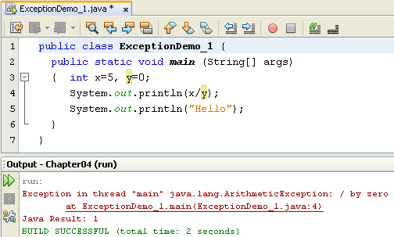
Exception
The following program causes an exception.
Exceptions are pre-defined data (Exception classes) thrown by JVM and they can be caught by code in the program

Slide 5

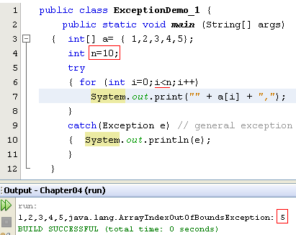
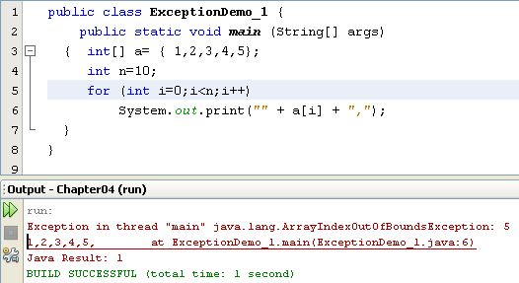
Kinds of Exception
Checked Exceptions
(We must use the try catch blocks or throw)
Unchecked- Exceptions
Program Bugs
(We may not use the try catch blocks)
Refer to the Java.lang documentation for more information.
Notes:
-Checked exceptions are checked at compile-time. It means if a method is throwing a checked exception then it should handle the exception using try-catch block or it should declare the exception using throws keyword, otherwise the program will give a compilation error. It is named as checked exception because these exceptions are checked at Compile time.
- What are Unchecked exceptions?
Unchecked exceptions are not checked at compile time. It means if your program is throwing an unchecked exception and even if you didn’t handle/declare that exception, the program won’t give a compilation error. Most of the times these exception occurs due to the bad data provided by user during the user-program interaction. It is up to the programmer to judge the conditions in advance, that can cause such exceptions and handle them appropriately. All Unchecked exceptions are direct sub classes of RuntimeException class.

Slide 6
Kinds of Exception
Checked exception
Must be handled by either the try-catch mechanism or the throws-declaration mechanism.
Runtime exception
The right time to deal with runtime exceptions is when you’re designing, developing, and debugging your code. Since runtime exceptions should never be thrown in finished code.

Slide 7
Catching exceptions: try catch finally mechanism
try block
try {
< statements may cause exceptions >
}
e?
false
true
catch ( ExceptionType1 e1 ) {
< statements handle the situation 1>
}
catch block
catch ( ExceptionType2 e2) {
< statements handle the situation 2>
}
finally block
finally {
< statements are always executed >
}
If no exception is thrown
in the try block, all catch blocks are bypassed
If an exception arises, the first matching catch block, if any, is executed, and the others are skipped

Slide 8
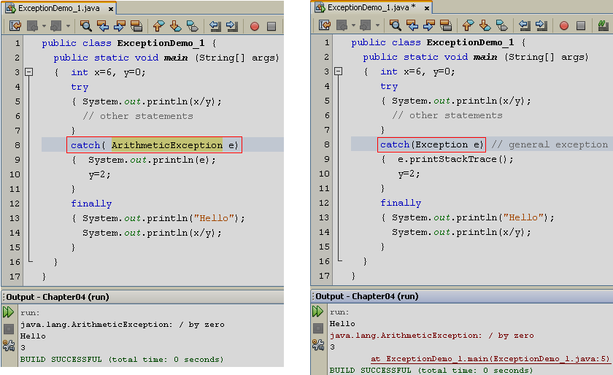
Catching specific/general-level exception
Type conformity: father=son;

Slide 9
The finally block (1)
A try block may optionally have a finally block associated with it.
The code within a finally block is guaranteed to execute no matter what happens in the try/catch code that precedes it.
The try block executes to completion without throwing any exceptions whatsoever.
The try block throws an exception that is handled by one of the catch blocks.
The try block throws an exception that is not handled by any of the catch blocks

Slide 10
Nesting of try/catch Blocks
A try statement may be nested inside either the try or catch block of another try statement.
try { // Pseudo code. open a user-specified file } catch (FileNotFoundException e) { try { // Pseudo code. open a DEFAULT file instead ... } catch (FileNotFoundException e2) { // Pseudo code. attempt to recover ... }
}

Slide 11
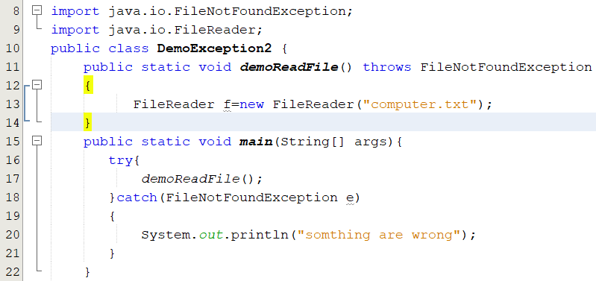
Catching exceptions: Throws mechanism
The throws keyword indicates what exception type may be thrown by a method.

Slide 12
Exception Propagations
catch(...)
A()
B()
Stack for A()
Stack for B()
C()
Stack for C()
D()
Exception
Stack for D()
Stack trace
When an exception occurs at a method, program stack is containing running methods ( method A calls method B,….). So, we can trace statements related to this exception.

Slide 13
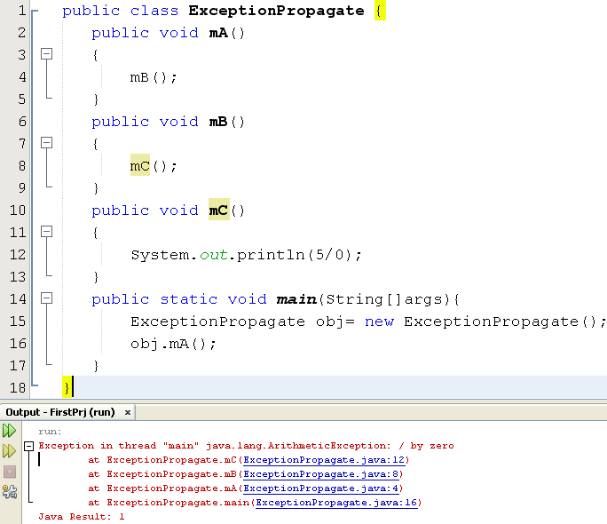
Exception Propagations

Slide 14
Example:Catching Exceptions
Using try…catch to input an integer ,10<=n<=50
public static int inputInteger(){
Scanner in = new Scanner(System.in);
boolean cont = true;
int n;
do {
try {
System.out.print(“Enter a whole number: ");
n = Integer.parseInt(in.nextLine());
cont = false;
} catch (Exception e) {
System.out.println("Required integer!");
}
} while (cont == true|| n<10 || n>50);
return n;
}
public static void main(String[] args){
int n= inputInteger();
System.out.print(“number:” + n);
}

Slide 15
Example:Catching Exceptions
Using try…catch to input an integer ,10<=n<=50
public static int inputInteger(){
Scanner in = new Scanner(System.in);
boolean cont = true;
int n;
do {
try {
System.out.print("Enter a whole number: ");
n = Integer.parseInt(in.nextLine());
if( n<10 || n>50) throw new Exception();
cont = false;
} catch (Exception e) {
System.out.println("Required integer!");
}
} while (cont==true);
return n;
}
public static void main(String[] args){
int n= inputInteger();
System.out.print("number:" + n);
}

Slide 16
Example:Catching Exceptions
Using try…catch to input an integer ,10<=n<=50
public static int inputInteger() throws Exception{
Scanner in = new Scanner(System.in);
System.out.print("Enter a whole number: ");
int n = Integer.parseInt(in.nextLine());
if( n<10 || n>50) throw new Exception();
return n;
}
public static void main(String[] args){
boolean cont=true; int n=0;
do{ try{ n= inputInteger();
cont=false;
}catch(Exception e){
System.out.println("Required integer!"); }
}while(cont==true);
System.out.print("number:"+ n);
}

Slide 17
Summary
We can use try-catch mechanism or throws mechanism to handle to avoid errors.
A single try block can have multiple catch blocks associated with it
Code Finalization and Cleaning Up (finally block)

